Slide 1

ECMASCRIPT 2015+

Slide 2
BROWSER
SERVER
HTTP + URL
NAVIGATION
HTML PAGES
CSS
HTML + CSS
HTTP + URL
HTML + CSS
Page
Reload!

Slide 3
BROWSER
SERVER
HTTP + URL
NAVIGATION
HTML + CSS
Server PAGES
CSS
HTTP + URL
ASP
ASP .NET
JSP
PHP
Ruby
HTML + CSS
Page
Reload!
DB

Slide 4
BROWSER
SERVER
HTTP + URL
NAVIGATION
Server PAGES
CSS
HTML + CSS + JS
AJAX - HTTP + URL
JS
Partial
Page
Reload!
PARTIAL HTML
<table>
<thead>
<tr>
<th>ID</th>
</tr>
</thead>
<tbody>
<tr>
<td>1</td>
</tr>
</tbody>
</table>
ASP
ASP .NET
JSP
PHP
Ruby
ASP .NET MVC
Spring MVC
Ruby On Rails
Laravel
DB

Slide 5
SERVER
Single Page Application (SPA)
SERVER PAGES
CSS
BROWSER
HTTP + URL
NAVIGATION
JS
HTML + CSS + JS
(Client Side JS App)
ASP
ASP .NET
JSP
PHP
Ruby
ASP .NET MVC
Spring MVC
Ruby On Rails
Laravel
<table>
<thead>
<tr>
<th>ID</th>
</tr>
</thead>
<tbody>
<tr>
<td>1</td>
</tr>
</tbody>
</table>
SERVER
AJAX - HTTP + URL
RESTful API
ASP .NET Web API
JWS
Express JS
Python
DB
JSON to HTML on Client Side
JSON
{
“id”:1
}
Vanilla JS, jQuery, KO, BB, NG1,
NG2 or above, Vue JS, React JS

Slide 6
SERVER
Single Page Application (SPA)
SERVER PAGES
CSS
BROWSER
HTTP + URL
NAVIGATION
JS
HTML + CSS + JS
(Client Side JS App)
ASP
ASP .NET
JSP
PHP
Ruby
ASP .NET MVC
Spring MVC
Ruby On Rails
Laravel
<table>
<thead>
<tr>
<th>ID</th>
</tr>
</thead>
<tbody>
<tr>
<td>1</td>
</tr>
</tbody>
</table>
Account
Service
AJAX - HTTP + URL
API GATEWAY
JSON
{
“id”:1
}
Inventory
Service
JSON to HTML on Client Side
Vanilla JS, jQuery, KO, BB, NG1,
NG2 or above, Vue JS, React JS
Shipping
Service

Slide 7
JavaScript Full Stack Application
 | Database | Application FW API FW | Client Side | Runtime
MEAN | MongoDB | Express JS | Angular | Node
MERN | MongoDB | Express JS | React JS | Node
MEVN | MongoDB | Express JS | Vue JS | Node

Slide 8
Installation
Install Node 14 LTS version - https://nodejs.org/en/
Install / Update Visual Studio Code to Latest Release - https://code.visualstudio.com/
Extensions of Visual Studio Code
AutoFileName
vscode-icons
JavaScript (ES6) code snippets
CSS Formatter
IntelliSense for CSS class names in HTML
Reactjs code snippets

Slide 9
Client Side Build
ES 2015 +
(Multiple Files)
Manual Configuration
Learn Node JS
Learn Webpack
Learn Babel & Config.
Babel +
Preset (Env) +
Polyfill (core-js)
Build & Deploy your
Project on Local Server
Build your project
Browser Compatible Files
(Multiple Files)
Auto Configuration
React CLI
WEBPACK-DEV-
SERVER
WEBPACK
CLI
Bundling
BROWSER
WEBPACK
Single File / Set of Files
Local
HTTP Server
HTML PAGE
Deploy
Inject Bundles

Slide 10
Webpack Configuration
Entry Point
Extensions
Loaders (Used to pre-process files)
Plugins
Optimization
Output

Slide 11
Install Packages
Webpack Related
"webpack": "5.33.2",
"webpack-cli": "4.6.0",
"webpack-dev-server": "3.11.2",
"webpack-merge": "5.7.3"
Loader
"babel-loader": "8.2.2",
"@babel/core": "7.13.15",
"@babel/preset-env": "7.13.15",
"file-loader": "6.2.0",
"html-loader": "2.1.2",
Plugins
"clean-webpack-plugin": "3.0.0",
"favicons-webpack-plugin": "5.0.2",
"favicons": "6.2.1",
"html-webpack-plugin": "5.3.1",
"progress-bar-webpack-plugin": "2.1.0",
"terser-webpack-plugin": "5.1.1",
Other Misc
"chalk": "4.1.0",
"serve": "11.3.2",
Polyfill
"core-js": "3.10.1"

Slide 12
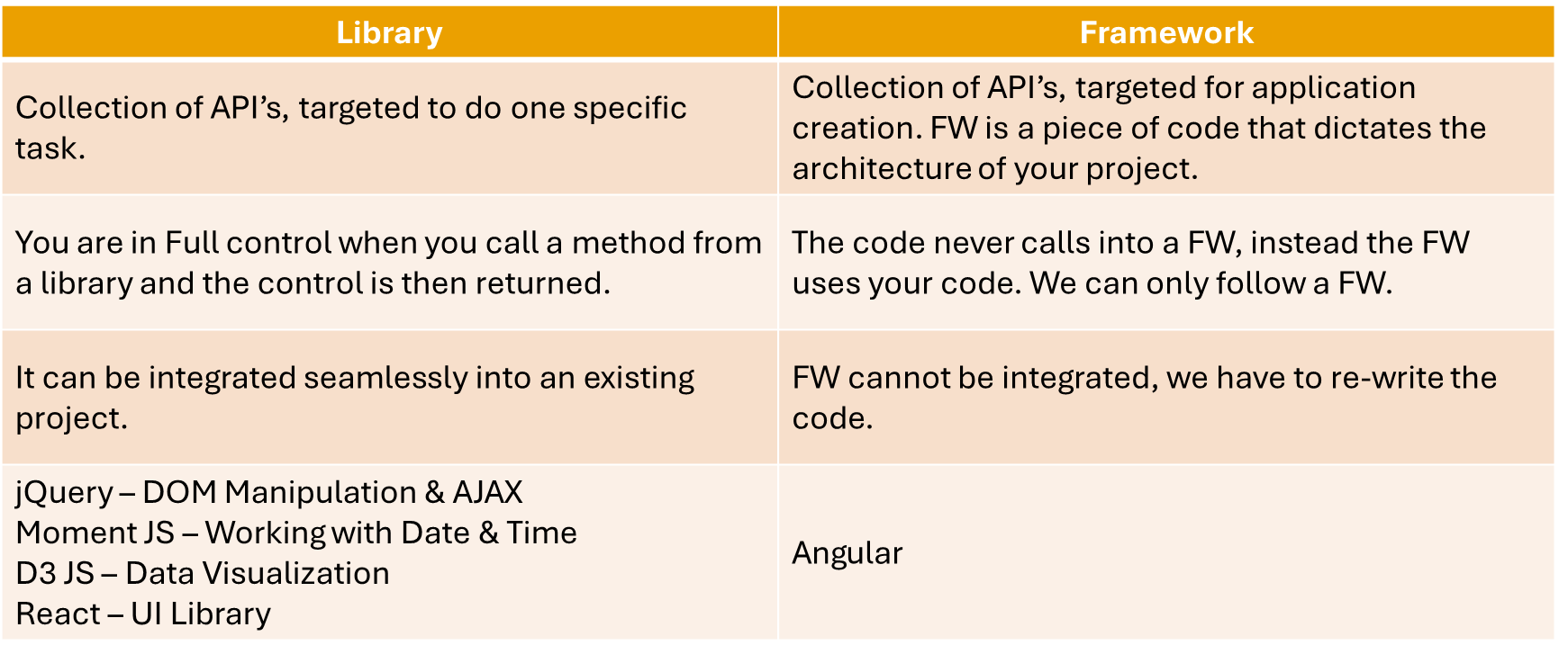
Library vs Framework

Slide 13
Datatypes
Primitive Types – Immutable
Primitive Values
undefined
null
Primitive Datatypes
string String()
number Number()
boolean Boolean()
symbol Symbol() – ES 6
Object Types – Mutable
object Object()

Slide 14
Mutable vs Immutable
JavaScript Engine handles mutable and immutable objects differently.
Immutable are quicker to access than mutable objects.
Mutable objects are great to use when you need to change the size of the object, example array, set etc..
Immutable are used when you need to ensure that the object you made will always stay the same.
Immutable objects are fundamentally expensive to “change”, because doing so involves creating a copy.
Changing mutable objects is cheap.

Slide 15
Statements
Control Flow
Block { }
break
continue
Empty
if…else
switch
throw
try…catch
Iterations
for
for...in
for…of
while
do…while

Slide 16
Functions
function
Declares a function with the specified parameters.
function*
Generator Functions enable writing iterators more easily.
async function
Declares an async function with the specified parameters.
return
Specifies the value to be returned by a function.

Slide 17
Pure and Impure Functions
A side-effect is any operation your function performs that is not related to computing the final output, including but not limited to:
Modifying a global variable
Modifying an argument
Making HTTP requests
DOM manipulation
Reading/writing files
A pure function must both be predictable and without side-effects. If either of these criteria is not met, we're dealing with an impure function.
A pure function, returns same result if same arguments are passed in, no matter how many times it runs.
An impure function, may return different result if same arguments are passed in, on multiple runs

Slide 18
Closure
A closure is a function or reference to a function together with a referencing environment — a table storing a reference to each of the non-local variables of that function.
Closures are functions that refer to independent (free) variables. In other words, the function defined in the closure 'remembers' the environment in which it was created.
A closure is a special kind of object that combines two things: a function, and the environment in which that function was created. The environment consists of any local variables that were in-scope at the time that the closure was created.

Slide 19
JavaScript ‘this’ keyword
In JavaScript, “context” refers to an object.
Within an object, the keyword “this” refers to that object, and provides an interface to the properties and methods that are members of that object.
When a function is executed, the keyword “this” refers to the object that the function is executed in.
Scenarios
When a function executes in the global context, “this” refers to the global, or “window” object
When a function is a method of an Object, “this” refers to that object (unless it is manually executed in the context of a different object)
When a function executes inside of another function (no matter how deeply nested), “this” refers to the object whose context within which it is executed
When you instantiate a constructor function, inside of the instance object, “this” refers to the instance object

Slide 20
Function Currying
Currying is a way of constructing functions that allows partial application of a function’s arguments.
What this means is that you can pass all the arguments a function is expecting and get the result or pass a subset of those arguments and get a function back that’s waiting for the rest of the arguments.

Slide 21
Higher Order Functions
Functions that operate on other functions, either by taking them as arguments or by returning them, are called higher-order functions.
Higher-order functions allow us to abstract over actions, not just values.

Slide 22
Person
p1
_name
getName()
setName(arg)
__proto__
Person.prototype
constructor
p2
_name
getName()
setName(arg)
__proto__

Slide 23
Person
p1
_name
__proto__
Person.prototype
constructor
getName()
setName(arg)
__proto__
Object.Prototype
constructor
hasOwnProperty()
toString()
p2
_name
__proto__

Slide 24
Vehicle.prototype
start()
__proto__
Fourwheeler.prototype
__proto__
Object.prototype
constructor
toString()
v
__proto__

Slide 25
Arrays
Arrays are an ordered collection that can hold data of any type. In JavaScript, arrays are created with square brackets [...] or using Array constructor and allow duplicate elements.
JavaScript objects and arrays were the most important data structures to handle collections of data.
The combination of objects and arrays was able to handle data in many scenarios, however, there were a few shortcomings as follows
Object keys can only be of type string.
Objects don't maintain the order of the elements inserted into them.
Objects lack some useful methods, which makes them difficult to use in some situations. For example, you can't compute the size (length) of an object easily. Also, enumerating an object is not that straightforward.
Arrays are collections of elements that allow duplicates. Supporting arrays that only have distinct elements requires extra logic and code.

Slide 26
Map
Map is a collection of key-value pairs where the key can be of any type. Map remembers the original order in which the elements were added to it, which means data can be retrieved in the same order it was inserted in.
In other words, Map has characteristics of both Object and Array:
Like an object, it supports the key-value pair structure.
Like an array, it remembers the insertion order.
A new Map can be created using Map Constructor.
Use Map when:
You may want to create keys that are non-strings. Storing an object as a key is a very powerful approach. Map gives you this ability by default.
You need a data structure where elements can be ordered. Regular objects do not maintain the order of their entries.
You are looking for flexibility without relying on an external library like lodash.

Slide 27
Set
A Set is a collection of unique elements that can be of any type.
Set is also an ordered collection of elements, which means that elements will be retrieved in the same order that they were inserted in.
A Set in JavaScript behaves the same way as a mathematical set.
Use Set when
You need to maintain a distinct set of data to perform set operations like union, intersection, difference, and so on.

Slide 28
Well-Known symbols
A list of symbols that JavaScript treats specially is published as well-known symbols.
Well-known symbols are used by built-in JavaScript algorithms. For example Symbol.iterator (@@iterator) is utilized to iterate over items in arrays, strings, or even to define your own iterator function.

Slide 29
Well-known symbol
Specification Name | [[Description]] | Value and Purpose
@@hasInstance | "Symbol.hasInstance" | A method that determines if a constructor object recognizes an object as one of the constructor’s instances. Called by the semantics of the instanceof operator.
@@isConcatSpreadable | "Symbol.isConcatSpreadable" | A Boolean valued property that if true indicates that an object should be flattened to its array elements by Array.prototype.concat.
@@iterator | "Symbol.iterator" | A method that returns the default Iterator for an object. Called by the semantics of the for-of statement.
@@match | "Symbol.match" | A regular expression method that matches the regular expression against a string. Called by the String.prototype.match method.
@@replace | "Symbol.replace" | A regular expression method that replaces matched substrings of a string. Called by the String.prototype.replace method.
@@search | "Symbol.search" | A regular expression method that returns the index within a string that matches the regular expression. Called by the String.prototype.search method.
@@species | "Symbol.species" | A function valued property that is the constructor function that is used to create derived objects.
@@split | "Symbol.split" | A regular expression method that splits a string at the indices that match the regular expression. Called by the String.prototype.split method.
@@toPrimitive | "Symbol.toPrimitive" | A method that converts an object to a corresponding primitive value. Called by the ToPrimitive abstract operation.
@@toStringTag | "Symbol.toStringTag" | A String valued property that is used in the creation of the default string description of an object. Accessed by the built-in method Object.prototype.toString.
@@unscopables | "Symbol.unscopables" | An object valued property whose own property names are property names that are excluded from the with environment bindings of the associated object.

Slide 30
Generators
In JavaScript, generators provide a new way to work with functions and iterators. Generators provide an easier way to implement iterators.
Using a generator,
you can stop the execution of a function from anywhere inside the function
and continue executing code from a halted position
To create a generator, you need to first define a generator function with function* symbol.
You can pause the execution of a generator function without executing the whole function body by using yield keyword.
The yield expression returns a value. However, unlike the return statement, it doesn't terminate the program. That's why you can continue executing code from the last yielded position.

Slide 31
Generator Methods
Method | Description
next() | Returns a value of yield
return() | Returns a value and terminates the generator
throw() | Throws an error and terminates the generator

Slide 32
Uses of Generators
Generators let us write cleaner code while writing asynchronous tasks.
Generators provide an easier way to implement iterators.
Generators execute its code only when required.
Generators are memory efficient.

Slide 33
Modules
As our application grows bigger, we want to split it into multiple files, so called “modules”.
Until ES6, JavaScript existed without a language-level module syntax.
JavaScript community invented a variety of ways to organize code into modules, special libraries to load modules on demand.
AMD – one of the most ancient module systems, initially implemented by the library require.js.
CommonJS – the module system created for Node.js server.
UMD – one more module system, suggested as a universal one, compatible with AMD and CommonJS.
The language-level module system appeared in the standard in ECMASCRIPT 2015

Slide 34
Modules
A module is just a file. One script is one module. As simple as that.
A module may contain a class or a library of functions for a specific purpose.
Modules can load each other and use special directives export and import to interchange functionality, call functions of one module from another one:
export keyword labels variables and functions that should be accessible from outside the current module.
import allows the import of functionality from other modules.

Slide 35
Promise
The Promise object represents the eventual completion (or failure) of an asynchronous operation, and its resulting value.
It allows you to associate handlers with an asynchronous action's eventual success value or failure reason.
This lets asynchronous methods return values like synchronous methods: instead of immediately returning the final value, the asynchronous method returns a promise to supply the value at some point in the future.

Slide 36
React
A JavaScript library for building user interfaces

Slide 37
Library vs Framework

Slide 38
HTML and CSS
HTML and CSS
+
-
+
-
domHandler
domHandler
Counter
{
count: 0,
next: function() { this.count +=1; } ,
prev: function() { this.count -=1; }
}
Counter
{
count: 0,
next: function() { this.count +=10; } ,
prev: function() { this.count -=10; }
}
<Counter />
<Counter interval=“10” />

Slide 39
Desktop Application
(Cross Platform)
ELECTRON JS
BROWSER (Client Side)
REACTDOM
REACT COMPONENT
View (UI) – JSX *
Style (CSS) – JSX / CSS
Data (Inside) – State
Data (Outside) – Props
Behaviour – Methods
Mobile Application
REACTNATIVE
Node JS App (Server Side)
REACTDOMSERVER

Slide 40
UI Composition
NAVIGATION
ADVER.
MENU ITEM
MENU ITEM
MENU ITEM
MENU ITEM
SIDE NAVIGATION
LIST AREA
DETAILS AREA
STATUS

Slide 41
React Installation
Install the React CLI (Once)
npm install -g create-react-app
Install Google Chrome Extensions
React Developer Tools
https://chrome.google.com/webstore/detail/react-developer-tools/fmkadmapgofadopljbjfkapdkoienihi
Redux DevTools
https://chrome.google.com/webstore/detail/redux-devtools/lmhkpmbekcpmknklioeibfkpmmfibljd

Slide 42
Using React CLI
To Create a new application
create-react-app first-app
cd first-app
Commands available in the application
npm start
Starts the development server.
npm run build
Bundles the app into static files for production.
npm run test
Starts the test runner.
npm run eject
Removes this tool and copies build dependencies, configuration files and scripts into the app directory. If you do this, you can’t go back!

Slide 43
React Client Side Build
ES 2015 +
(Multiple Files)
Manual Configuration
Learn Node JS
Learn Webpack
Learn Babel & Config.
react-scripts
Babel + Preset (React)
Preset (Env) +
Polyfill (core-js)
Build & Deploy your
Project on Local Server
Build your project
Browser Compatible Files
(Multiple Files)
Auto Configuration
create-react-app (React CLI)
WEBPACK-DEV-
SERVER
WEBPACK
CLI
Bundling
BROWSER
WEBPACK
Single File / Set of Files
Local
HTTP Server
HTML PAGE
Deploy
Inject Bundles

Slide 44
State
The state is an updatable structure that is used to contain data or information about the component and can change over time.
The change in state can happen as a response to user action or system event.
It is the heart of the react component which determines the behavior of the component and how it will render.
It represents the component's local state or information.
It can only be accessed or modified inside the component or by the component directly.

Slide 45
Props
Props are read-only structure.
It is an object which stores the value of attributes of a component and work similar to the HTML attributes.
It allows passing data from one component to other components.
Props are immutable so we cannot modify the props from inside the component.

Slide 46
Props vs State
Props | State
Props are read-only. | State changes can be asynchronous.
Props are immutable. | State is mutable.
Props allow you to pass data from one component to other components as an argument. | State holds information about the components.
Props can be accessed by the child component. | State cannot be accessed by child components.
Props are used to communicate between components. | States can be used for rendering dynamic changes within the component.
Props make components reusable. | State cannot make components reusable.
Props are external and controlled by whatever renders the component. | The State is internal and controlled by the React Component itself.

Slide 47
props
Call setState()
React Component
(state)
Render function of the
Component is called by
Event Fired
ReactDOM.render
Ready for User Interaction
DELTA’s will be rendered and Browser DOM will update
Virtual DOM
New Virtual DOM is compared with the Old Virtual DOM
DELTA’s

Slide 48
Methods & Properties in a React Component
Instance Methods
setState()
forceUpdate()
Instance Properties
props
state
Class Properties (static)
defaultProps
displayName
propTypes

Slide 49
Lifecycle Methods in a React Component
Mounting Phase
constructor()
static getDerivedStateFromProps()
render()
componentDidMount()
Updating Phase
static getDerivedStateFromProps()
shouldComponentUpdate()
render()
getSnapshotBeforeUpdate()
componentDidUpdate()
Unmounting Phase
componentWillUnmount()
Error Phase
static getDerivedStateFromError()
componentDidCatch()

Slide 50
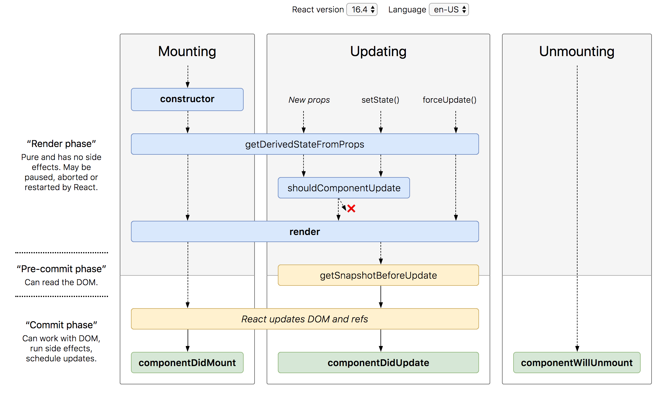
Lifecycle Methods

Slide 51
SyntheticEvent Object
Your event handlers will be passed instances of SyntheticEvent, a cross-browser wrapper around the browser’s native event.
It has the same interface as the browser’s native event, including stopPropagation() and preventDefault(), except the events work identically across all browsers.
The synthetic events are different from, and do not map directly to, the browser’s native events.

Slide 52
SyntheticEvent object attributes
boolean bubbles
boolean cancelable
DOMEventTarget currentTarget
boolean defaultPrevented
number eventPhase
boolean isTrusted
DOMEvent nativeEvent
void preventDefault()
boolean isDefaultPrevented()
void stopPropagation()
boolean isPropagationStopped()
void persist()
DOMEventTarget target
number timeStamp
string type

Slide 53
Rules to follow
The data flows unidirectionally, from state to the template of the component or from parent to child.
The state of the component, can be modified only by the method of the same component.

Slide 54
Controlled Component
A controlled component is bound to a value, and its changes will be handled in code by using event-based callbacks.
The input form element is handled by the react itself rather than the DOM.
The mutable state is kept in the state property and will be updated only with setState() method.
Controlled components have functions that govern the data passing into them on every onChange event occurs.
The data is then saved to state and updated with setState() method. It makes component have better control over the form elements and data.

Slide 55
Uncontrolled Component
It is similar to the traditional HTML form inputs. Here, the form data is handled by the DOM itself.
It maintains their own state and will be updated when the input value changes.
To write an uncontrolled component, there is no need to write an event handler for every state update.
You can use a ref to access the value of the form from the DOM.

Slide 56
Controlled vs Uncontrolled
Controlled | Uncontrolled
It does not maintain its internal state. | It maintains its internal states.
Here, data is controlled by the parent component. | Here, data is controlled by the DOM itself.
It accepts its current value as a prop. | It uses a ref for their current values.
It allows validation control. | It does not allow validation control.
It has better control over the form elements and data. | It has limited control over the form elements and data.

Slide 57
Typechecking With PropTypes
As your app grows, you can catch a lot of bugs with typechecking.
React has built-in typechecking abilities.
To run typechecking on the props for a component, you can assign the propTypes property.
You must use the prop-types library.
npm i prop-types
PropTypes exports a range of validators that can be used to make sure the data you receive is valid.

Slide 58
Assignment
Complete the Calculator and Counter Assignment as per the problem statement shared in the code base.
Day 3 -> react-core -> src -> components -> 15_assignment

Slide 59
CRUD Assignment
Complete the CRUD assignment as per the screenshot shared in the next slide, use array to keep the data.
Create form-component and data-table-component as sibling components.
The data-table-component should be able to display array of any kind objects, do not fix the table to show only employees.

Slide 60
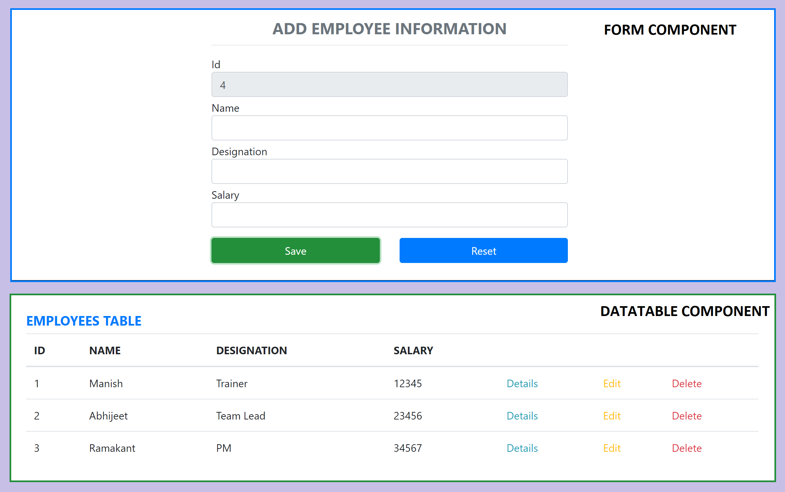
CRUD Assignment

Slide 61
Parent Child Communication
PARENT
PARENT
Props
ref
Parent
Method
Reference
CHILD
CHILD

Slide 62
Sibling Communication
Parent Component
Parent
Method
Reference
props
CHILD Component
1
CHILD Component
2

Slide 63
Error Boundaries
If the errors are not handled, the react component will crash and show a blank UI.
Error boundaries are React components that catch JavaScript errors anywhere in their child component tree, log those errors, and display a fallback UI instead of the component tree that crashed.
Error boundaries catch errors during rendering, in lifecycle methods, and in constructors of the whole tree below them.
Error boundaries do not catch errors for:
Event handlers
Asynchronous code (e.g. setTimeout or requestAnimationFrame callbacks)
Server side rendering
Errors thrown in the error boundary itself (rather than its children)

Slide 64
Create an Error Boundary
A class component becomes an error boundary if it defines either (or both) of the lifecycle methods static getDerivedStateFromError() or componentDidCatch()
Use static getDerivedStateFromError() to render a fallback UI after an error has been thrown.
Use componentDidCatch() to log error information.
The granularity of error boundaries is up to you.
You may wrap top-level components to display a “Something went wrong” message to the user, just like how server-side frameworks often handle crashes.
You may also wrap individual components in an error boundary to protect them from crashing the rest of the application.

Slide 65
AJAX and APIs
You can use any AJAX library you like with React.
Some popular libraries are:
Axios
jQuery AJAX
window.fetch
XMLHttpRequest
You should populate data with AJAX calls in the commit phase lifecycle methods like componentDidMount().
Use setState to update your component when the data is retrieved.

Slide 66
Context
In a typical React application, data is passed top-down (parent to child) via props, but such usage can be cumbersome for certain types of props that are required by many components within an application.
Context provides a way to share values between components without having to explicitly pass a prop through every level of the tree.

Slide 67
Sibling Communication
CONTEXT
Parent Component
CHILD Component
1
CHILD Component
2

Slide 68
Hooks
Hooks are a new addition in React 16.8.
Hooks let you use state and other React features without writing a class.
Hooks are backwards-compatible
Built in Hooks
Basic Hooks
useState
useEffect
useContext
Additional Hooks
useReducer
useCallback
useMemo
useRef
useImperativeHandle
useLayoutEffect
useDebugValue

Slide 69
NODE SERVER
BROWSER
HTTP + URL (localhost:3000)
NAVIGATION
React Application
HTML Page + JS (React App)
NODE SERVER
EXPRESS JS
Web API
AJAX – localhost:8000/api/products
Database
JSON

Slide 70
NODE SERVER
BROWSER
HTTP + URL (localhost:3000)
NAVIGATION
React Application
Click on Admin Link, code
To verify token is in sessionStorage, if not, we will be redirected to Login View
HTML Page + JS (React App)
HTTP + URL (AJAX) + Username & Password
NODE SERVER
EXPRESS JS
Web API
JSON with Token
{“token”:”___”}
Store Token in Session
Storage of the browser
Send the same token to
Access data from the
server
AJAX – localhost:8000/api/products + Token
Database
JSON

Slide 71
Secure Application using Custom Route
When user clicks the Admin Link, we need to verify that we have a token in session storage, and if the token in not there in the session storage, redirect the request to login component. (SecuredRoute)
SecuredRoute uses AuthenticatorClient’s isAuthenticated to verify.
If false, the request is redirected to Login Component
If true, the request is allowed for Admin Component.
Logging and Token Management (AuthenticatorClient)
On Login Component, user must give username and password, which will be sent to Node API Server
If the username & password is correct, in the response; token will come from the Server
Received token will be stored in the session storage of the browser.
Reading and Attaching Token
Whenever the AJAX request is made for api, we must read and attach the token in the request header.
We use AuthenticatorClient to read the token from session storage.

Slide 72
Assignment
Complete the CRUD assignment by communicating with the node server running on localhost:8000/api/users.
Change the Login Area on NavigationComponent to Logout area when the user is already logged in.
Learn about fetch interceptor
Learn how to use React Final Form to create Login Component

Slide 73
Higher Order Components
A higher-order component (HOC) is an advanced technique in React for reusing component logic.
HOCs are not part of the React API, per se.
They are a pattern that emerges from React’s compositional nature.
A higher-order component is a function that takes a component and returns a new component.
Use HOCs For Cross-Cutting Concerns

Slide 74
Redux
Redux is a pattern and library for managing and updating application state, using events called "actions".
It serves as a centralized store for state that needs to be used across your entire application, with rules ensuring that the state can only be updated in a predictable fashion.
The patterns and tools provided by Redux make it easier to understand when, where, why, and how the state in your application is being updated, and how your application logic will behave when those changes occur.

Slide 75
When Should I Use Redux?
Redux helps you deal with shared state management, but like any tool, it has tradeoffs. There are more concepts to learn, and more code to write. It also adds some indirection to your code and asks you to follow certain restrictions. It's a trade-off between short term and long-term productivity.
Redux is more useful when:
You have large amounts of application state that are needed in many places in the app
The app state is updated frequently over time
The logic to update that state may be complex
The app has a medium or large-sized codebase, and might be worked on by many people
Not all apps need Redux. Take some time to think about the kind of app you're building and decide what tools would be best to help solve the problems you're working on.

Slide 76
1
Will use the action types to identify an action which is dispatched, to do a specific operation on Store State
ACTION TYPE
Constants (string / symbol)
Will use action types to create an action object
3
R1
R2
R3
2
ACTION CREATOR
A function which creates and returns an Action object
ROOT REDUCER
REDUX STORE
Application State
4
ACTION OBJECT
Plain JavaScript Object
{
type: ActionType,
payload: data
}
CONTAINER COMPONENT
5
Dispatch
Action
Data Flow
PRESENTATIONAL COMPONENT (s)
6
mapDispatchToProps
mapStateToProps
Connection to Action Creator(s)
Connection to Reducer(s)

Slide 77
Redux Terminology
Actions - An action is a plain JavaScript object that has a type field. You can think of an action as an event that describes something that happened in the application.
Action Creators - An action creator is a function that creates and returns an action object. We typically use these so we don't have to write the action object by hand every time
Reducers - A reducer is a function that receives the current state and an action object, decides how to update the state if necessary, and returns the new state. You can think of a reducer as an event listener which handles events based on the received action (event) type.
Store - The current Redux application state lives in an object called the store . The store is created by passing in a reducer.
Dispatch - The Redux store has a method called dispatch. The only way to update the state is to call store.dispatch() and pass in an action object. The store will run its reducer function and save the new state value inside. You can think of dispatching actions as "triggering an event" in the application.
Selectors - Selectors are functions that know how to extract specific pieces of information from a store state value.

Slide 78
Redux Application Data Flow

Slide 79
Thunk Middleware – Async Data Flow
Thunk is a logical concept in programming where you deal with a function that is primarily used to delay the calculation or evaluation of any operation.
Redux Thunk acts as a middleware that will return you a function instead of an object while calling through the action creators.
The returned function receives the dispatch method from the store and then later it is used to dispatch synchronously inside the body of function once the asynchronous actions have been completed.

Slide 80
1
Will use the action types to identify an action which is dispatched, to do a specific operation on Store State
ACTION TYPE
Constants (string / symbol)
Will use action types to create an action object
Dispatch
Action
3
R1
R2
R3
2
ACTION CREATOR
A function which creates and returns an Action object
REDUX
THUNK
MIDDLEWARE
API SERVER
ROOT REDUCER
A function that takes parameter dispatch
REDUX STORE
Application State
4
ACTION OBJECT
Plain JavaScript Object
{
type: ActionType,
payload: data
}
CONTAINER COMPONENT
5
Dispatch
To Function
Data Flow
PRESENTATIONAL COMPONENT (s)
6
mapDispatchToProps
mapStateToProps
Connection to Action Creator(s)
Connection to Reducer(s)

Slide 81
Redux Application Async Data Flow

Slide 82
Assignment
Complete the Requested and Failed logic for
Insert
Update
Delete
In the Redux application consume the node-api-server, which we have used for Day 4 demos

Slide 83

Contact Me
Manish Sharma | Gmail
Manish Sharma | WhatsApp
Manish Sharma | Facebook
Manish Sharma | LinkedIn

